Slide 1
FinSphereAI: Elevating Enterprise Financial Auditing with Autonomous Agents
Bridging the gap between generative language models and deterministic machine learning
Sathvik Gattu
gattu.sathvikgoud@gmail.com
+91 9959950956
Notes:
We are going to look at how to bridge the gap between language models and deterministic machine learning.
My goal is to show you how autonomous agents can completely eliminate financial hallucinations.
Tech Stack : Application Layer: React / Next.js (Frontend), Python FastAPI / Flask (Backend API).
AI & Orchestration: LangChain (ReAct Agent), OpenAI / Gemini APIs (LLM Engine).
Data & Retrieval: ChromaDB (Vector Store), SentenceTransformers all-MiniLM-L6-v2 (Embeddings).
Machine Learning (Solvers): Scikit-learn (Random Forest, Ridge Regression, Isolation Forest).

Slide 2
Problem Statement
The Manual Bottleneck - Financial auditing is currently a slow, human-intensive process, susceptible to oversight and calculations mismatch.
The Hallucination Loophole - Standard Generative AI (LLMs) cannot be trusted with raw financial calculations. They frequently hallucinate numbers, miscalculate solvency ratios, and struggle to process unstructured PDF balance sheets.
Disconnected Systems - Traditional corporate systems separate text-based search (filings documents) from predictive model engines (bankruptcy forecasting, anomaly scanners), forcing human auditors to manually copy-paste metrics between interfaces.
Notes:
The current financial audit process is a severe manual bottleneck, relying on disconnected legacy systems.
Generative AI seems like a fix, but standard LLMs fall into the "hallucination loophole" when handling raw math.
You cannot trust a standard chatbot to calculate a company's solvency ratio off a messy PDF balance sheet.
Auditors are stuck manually porting metrics between unstructured text search and predictive engines.

Slide 3
Features
Unified Interface: A centralized workspace replacing fragmented legacy tools, allowing auditors to fetch SEC filings and trigger analysis in one screen.
Document Library Management: Secure, session-isolated storage for raw financial PDFs (10-Ks, 10-Qs).
Real-Time Context Injection: Chat interface dynamically references the specific documents the user has actively selected in the workspace.
Notes:
To solve this, FinSphereAI acts as a unified AI copilot workspace.
It replaces those fragmented tools, giving auditors a single interface for secure, session-isolated document management.
Instead of switching tabs, the user selects a 10-K filing, and the system dynamically injects it into the chat context.
It bridges the gap between raw document storage and active analysis.

Slide 4
Advanced Deterministic Solvers
Solvency Engine: Executes the Altman Z-Score local model for instant, statistically sound bankruptcy risk scoring
Revenue Forecasting: Utilizes Ridge Regression algorithms for time-series projection of growth trajectories.
Anomaly Scanner: Deploys Isolation Forest models to detect mathematical outliers and inconsistencies in corporate reporting.
Notes:
This is where we leave standard LLMs behind and introduce deterministic machine learning.
The platform hosts a Solvency Engine running a local Altman Z-Score model for instant bankruptcy risk scoring.
We use Ridge Regression to project quarterly revenue trajectories based on historical patterns.
Finally, an Isolation Forest anomaly scanner automatically flags inconsistencies in corporate reporting.

Slide 5
Introducing the FinSphereAI ReAct Chatbot Agent
ReAct (Reasoning and Action) Loop
The chatbot utilizes the ReAct framework to perform step-by-step reasoning. Instead of generating a single output directly, the agent executes an iterative loop:
Thought: Evaluates what financial data or calculation is required to answer the query.
Action: Selects and runs the appropriate tool (e.g. vector search, ratio calculation, anomaly check).
Observation: Inspects the tool's quantitative output to determine if more data is needed.
Notes:
The brain of this operation is the ReAct chatbot agent.
Standard models just generate text, but this agent operates in a continuous loop of reasoning and action.
First, it stops to "Think" and determine exactly what financial data is required.
Then it takes an "Action" by executing a specific tool, observing the output to decide if it has the final answer.

Slide 6
Introducing the FinSphereAI ReAct Chatbot Agent
Hybrid Architecture
Conversational Reasoning Core: LangChain-orchestrated agent binding user session context and multi-turn chat memory.
Deterministic Predictive Solvers: Local model tools (Random Forest, Isolation Forest, Ridge Regression) executing mathematical solvers behind the scenes to guarantee 100% calculation accuracy.
Notes:
This creates a true hybrid architecture that gives us the best of both worlds.
We use a LangChain-orchestrated core to handle the conversational reasoning and multi-turn memory.
But we strictly offload the heavy lifting to our deterministic predictive solvers.
This guarantees 100% calculation accuracy while maintaining a natural, conversational user experience.

Slide 7
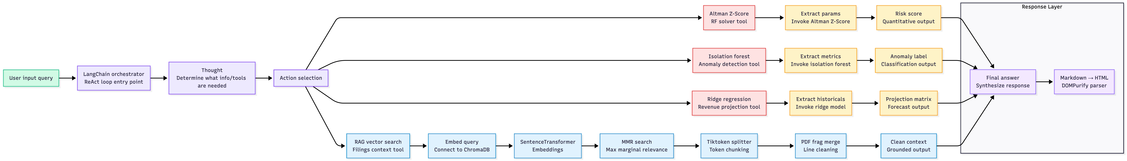
System Architecture Flowchart How Information and Decisions Flow Through the Agent
Notes:
This flowchart represents the core brain of the project. When a user inputs a query, it doesn't just pass through an LLM for a static response. It enters a LangChain-orchestrated ReAct loop.
The agent first stops to 'Think'—it evaluates exactly what financial data is required. From there, the action selection routing takes over. If the user asks a qualitative question, like 'What are the risks?', it routes down the bottom path: embedding the query via SentenceTransformers and pulling grounded context from ChromaDB using MMR.
However, if the user asks a mathematical question—like calculating a bankruptcy risk—the agent bypasses the RAG database entirely. It routes to the top paths, extracting the parameters and invoking our local ML Solvers, like the Random Forest Altman Z-Score tool.
Finally, whether it pulled text from a PDF or a numerical score from a python model, all that raw data converges back at the Response Layer. The agent synthesizes the findings and outputs a clean, DOMPurify-parsed HTML report. It's a continuous loop of reasoning, routing, and synthesizing."

Slide 8
Agent Orchestration & Memory Mechanics
Agent Executor Framework: Handles the Thought -> Action -> Observation loop, specifically managing tool-calling retry logic if an execution fails.
Strict Tool Binding: Utilizes Pydantic schemas to tightly bind LLM instructions to Python execution functions, ensuring the LLM passes the exact correct parameters (e.g., total_assets, total_liabilities) to the solver tools.
Dynamic Memory Buffer: Implements ConversationSummaryBufferMemory to prune older, irrelevant chat tokens while preserving essential financial context across multi-turn interactions.
Notes:
Under the hood, the Agent Executor handles the logic, specifically managing tool retries if something breaks.
We use strict Pydantic schemas so the LLM is forced to pass exact, correct parameters to our Python functions.
To keep costs down and context relevant, a dynamic buffer memory prunes older tokens.
This ensures the agent never loses the essential financial thread of the conversation.

Slide 9
The Data Ingestion Pipeline & Semantic Parsing
Persistent Vector Storage: Built on ChromaDB utilizing all-MiniLM-L6-v2 embeddings for highly efficient financial document retrieval.
Maximum Marginal Relevance (MMR): Retrieval is configured with MMR to guarantee extracted document chunks are diverse and non-redundant, giving the agent a broader context.
Semantic Context Reconstruction: Engineered custom parsing logic to normalize hard line breaks in PDFs. The code merges disjointed line fragments back into grammatically complete sentences before embedding, eliminating noise in the RAG pipeline.
Notes:
Data ingestion isn't just loading PDFs; it requires cleaning to prevent noise in the RAG pipeline.
We utilize ChromaDB with MMR retrieval to ensure we pull diverse, non-redundant context.
Most importantly, I engineered custom logic to merge broken line fragments back into complete grammatical sentences.
This semantic reconstruction is what keeps the extracted financial context pristine.

Slide 10
Execution Logic (The Math Offloading Engine)
Architecture Principle: The agent acts strictly as an orchestrator, routing requests, rather than a raw mathematical generator.
Direct Solver Offloading: When a user requests a solvency calculation, the agent extracts the parameters and triggers a local Python script (Random Forest) instead of calculating it in the prompt window.
Result Synthesis: The raw quantitative output from the Python model is passed back to the LLM to format into a clean, human-readable executive summary.
Notes:
The core engineering principle here is that the agent is an orchestrator, not a raw calculator.
When someone asks for a solvency score, the agent extracts the assets and liabilities, and hands them to a Python script.
The Python model computes the exact math and hands the raw output back.
The LLM simply formats that quantitative result into a clean, human-readable summary.

Slide 11
System Resilience: Handling Edge Cases & Failures
WHAT IF THE LOCAL MODEL FAILS?
AgentExecutor Retry Logic: Configured LangChain’s AgentExecutor to capture tool-level Python exceptions (ValueError, TypeError) as Observations rather than fatal crashes.
Self-Correction Loop: The ReAct agent reads the error, understands the parameter mismatch, and autonomously re-triggers the tool with corrected data.
Graceful Degradation: Implemented a hard limit (e.g., 3 retries). If the calculation repeatedly fails, the agent outputs a deterministic error message ("Insufficient data for Z-Score") strictly preventing arithmetic hallucinations.
WHAT IF THE PDF IS ENTIRELY UNREADABLE?
Pre-Ingestion Validation: Pipeline evaluates extraction yield before embedding. If a 100-page PDF returns fewer than a threshold of tokens, the system flags it as non-machine-readable.
RAG Contamination Prevention: Corrupt or empty documents are hard-blocked from entering ChromaDB, ensuring the vector space remains dense and contextually relevant.
User Feedback Loop: Instantly alerts the user in the UI to run OCR (Optical Character Recognition) on the document before retrying.
Notes:
Model Fails :
A robust system must anticipate failures, especially when passing data between an LLM and local code.
If the LLM passes a string instead of an integer, the AgentExecutor catches the Python exception as an observation.
The agent reads its own error, corrects the parameter mismatch, and autonomously tries again.
If it fails repeatedly, it degrades gracefully with a clean error, completely preventing a hallucinated guess.
PDF FAILS :
I also built safeguards against bad data, like unreadable or scanned PDFs.
A pre-ingestion check evaluates the token yield before anything is allowed to be embedded.
If a document is empty or corrupt, it is hard-blocked from entering ChromaDB to prevent vector contamination.
The UI then instantly alerts the user to run OCR, keeping our database highly accurate.

Slide 12
Chatbot Token Optimization Framework
How I Optimized (Implemented in my Project)
Token-Bound Splitting: Swapped character splitting for tiktoken encoder splitting (500 tokens, 100 overlap) to align chunks exactly with LLM tokenizer boundaries.
Math Offloading: Moved heavy solvency, anomaly, and forecasting calculations to local python models, saving thousands of reasoning tokens inside the context window.
How to Optimize More
Semantic Prompt Caching: Cache semantic vector embeddings of query-response pairs to answer repeated questions without invoking the LLM.
Dynamic Tool Masking: Program the LangChain agent to only inject instructions/schemas for relevant tools based on query intent classification.
Context Fact Extraction: Pass raw retrieved chunks to a local, lightweight summarizer to extract key-value metrics, pruning context noise before prompt injection.
Notes:
Optimization was a massive priority for scaling and lowering latency.
I swapped standard character splitting for tiktoken encoder splitting to perfectly align chunks with the LLM's boundaries.
Offloading math to local Python models saved thousands of reasoning tokens per query.
Looking ahead, semantic prompt caching will allow us to answer repeated queries without even invoking the LLM.

Slide 13
Future Work & Scaling
Vectorless RAG (GraphRAG)
Move beyond simple vector search. Build a relational Knowledge Graph (e.g. using Neo4j) mapping company entities, balance sheets, and formulas for context-free, highly accurate grounding.
Advanced Multi-Agent Swarms
Orchestrate specialized sub-agents using CrewAI or LangGraph: Compliance Agent (auditing legal, regulatory disclosures), Quant ML Agent (running predictive solvers), Synthesis Agent (synthesizes reports into clean executive HTML).
Real-time Ingestion Pipelines
Automate pipeline feeds from SEC EDGAR RSS feeds to dynamically index the latest 10-K and 10-Q corporate reports.
Notes:
As we look toward scaling, transitioning to a GraphRAG setup with Neo4j will provide context-free formula grounding.
I also plan to introduce multi-agent swarms, separating compliance auditing from quantitative ML tasks.
Finally, automating the ingestion pipeline directly from SEC EDGAR RSS feeds will make the platform real-time.
This lays the groundwork for a truly global, automated auditing tool.

Slide 14
System Impact & Hallucination Mitigation
Accuracy Guarantee: Offloading math to local solvers (Random Forest/Ridge) reduced calculation hallucinations to 0%.
Token Efficiency: By utilizing tiktoken optimization and shifting math execution out of the prompt window, response latency and token costs were significantly reduced.
Context Purity: The semantic context reconstruction technique completely eliminated RAG retrieval failures caused by fragmented PDF tables.
Audit Velocity: By unifying RAG retrieval with deterministic solvency solvers, the time required to manually audit corporate filings and extract risk metrics is reduced from hours to seconds, building immediate trust in the AI's output.
Notes:
Ultimately, this architecture solved the enterprise problem we started with.
By offloading math to Random Forest and Ridge models, we reduced calculation hallucinations to zero percent.
Token optimization and clean ingestion significantly reduced latency and eliminated RAG retrieval failures.
This drops the manual audit time from hours to seconds, building immediate trust in the AI's output.

Slide 15
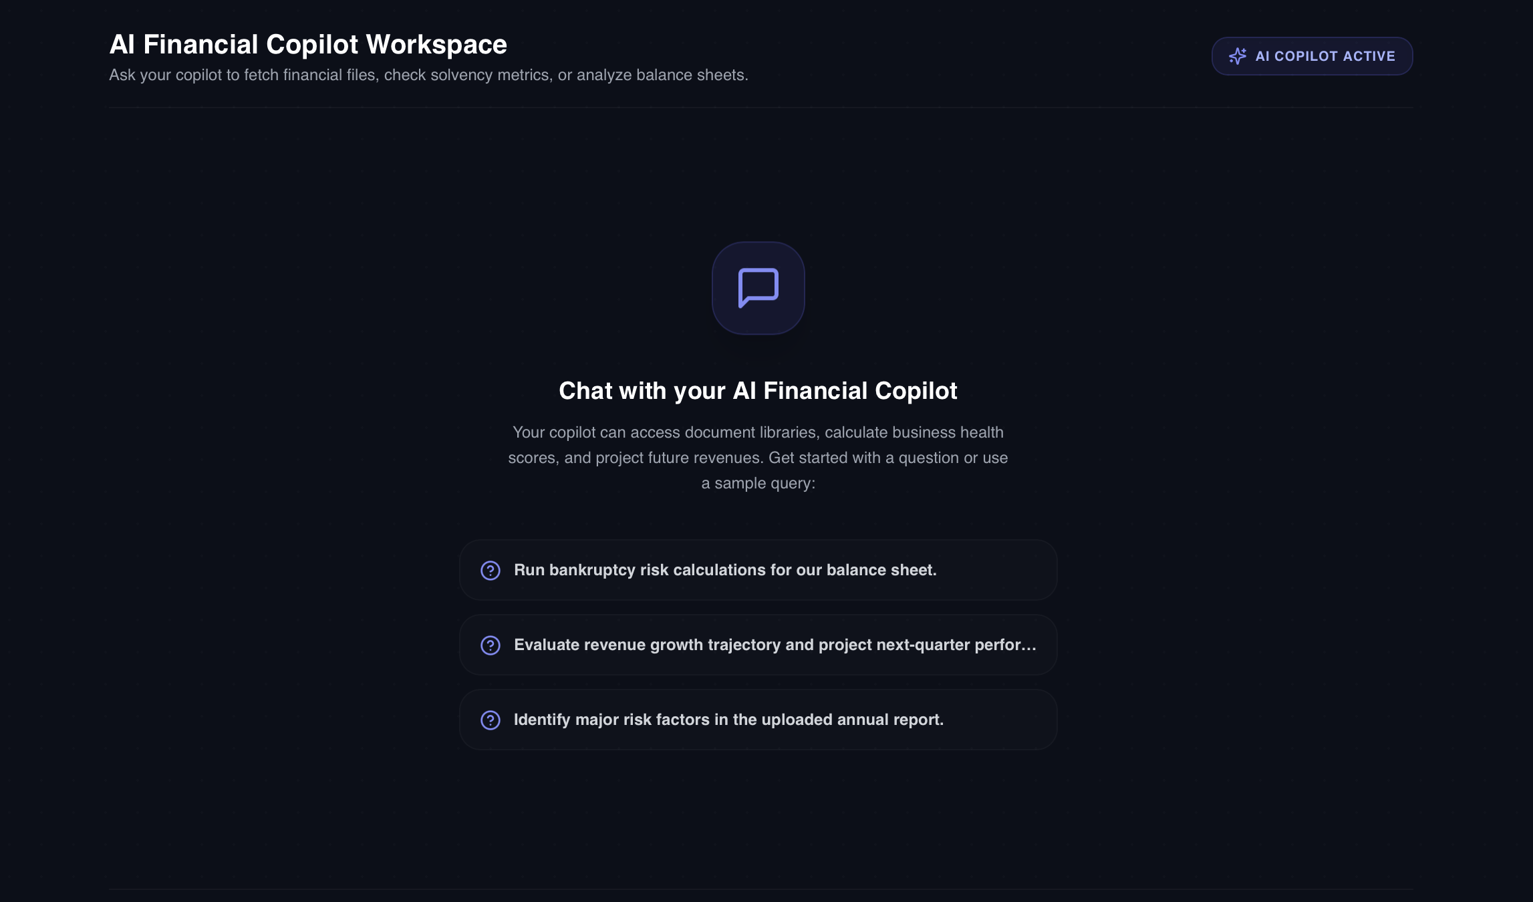
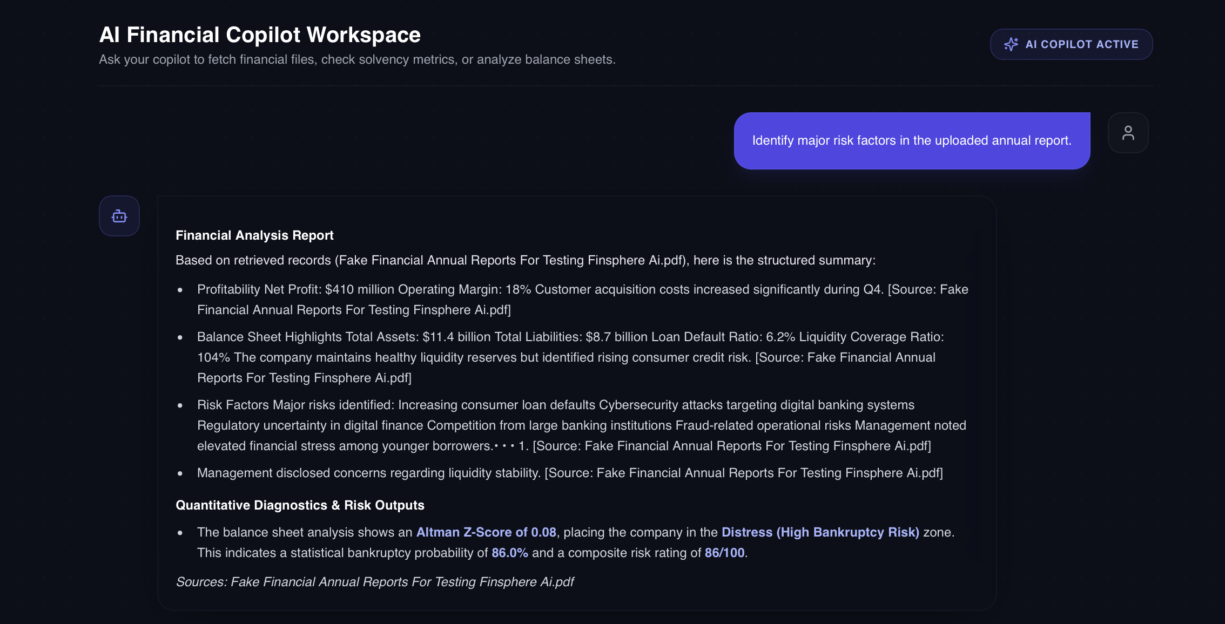
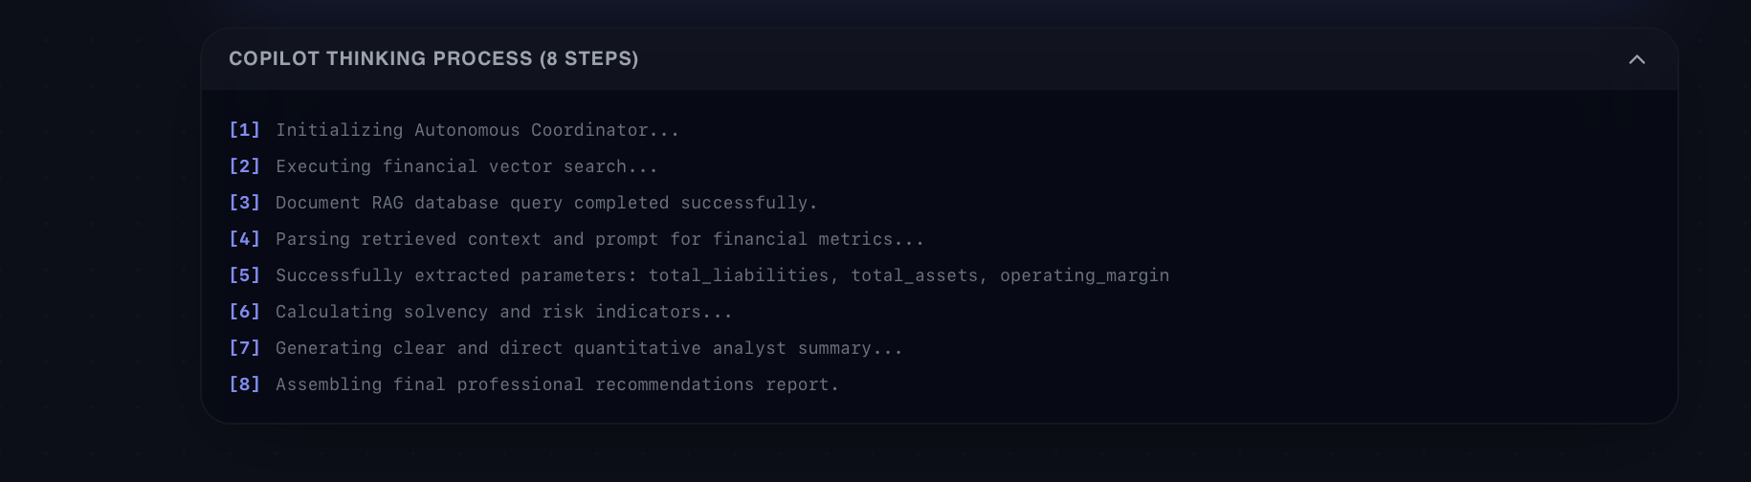
Demo
Notes:
Let's take a brief look at the interface in action.
You can see the clean workspace where users can query specific filings for major risk factors.
Notice how the final output seamlessly synthesizes RAG context with a direct Altman Z-Score calculation.
Behind the scenes, the copilot thinking process logs prove the autonomous routing in real-time.

